Slide 1
Cancer Cellularity in Breast Pathology Slides
Shant Ayanian
Talal Alzahrani

Slide 2
Overview
Background
Goal of the Project
Datasets
Framework/Codes
Results

Slide 3
Background
Breast cancer is the most common cancer and the second most cause of cancer-related death in women.
The treatment of breast cancer depends on the pathological grade of the cancer.
Quantitative cancer cellularity in pathological slides is important for treatment and prognosis.

Slide 4
Aim
To develop convolutional neural network algorithms to determine cancer cellularity in breast cancer hematoxylin and eosin (H&E) stained pathological slides.
To compare the performance of different convolutional neural network architecture in determining cancer cellularity.

Slide 5
Dataset
The SPIE (the international society for optics and photonics) 2018-2019, along with the American Association of Physicists in Medicine (AAPM), and the National Cancer Institute (NCI) provide this dataset as part of a challenge.
The aim of this challenge is to develop an algorithm that accurately predict cancer cellularity in the provided dataset.

Slide 6
Dataset
The data is a set of 2570 patches from 64 H&E slides presented in 512*512 size, in a tif format.

Slide 8
Datasets
The patches are graded by expert pathologists in terms of their cellularity from 0 to 1.
These represent the label for each image, which are presented in a separate csv file.

Slide 9
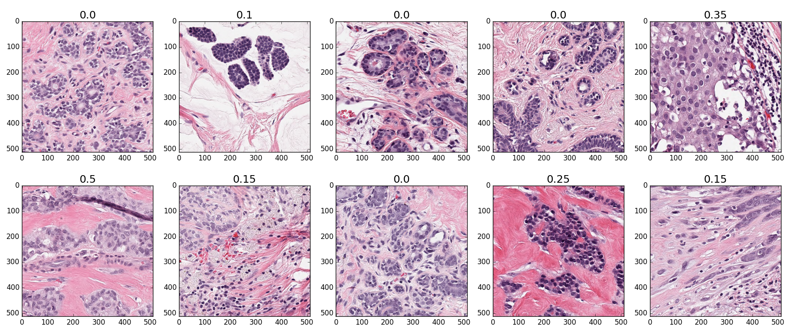

Slide 10
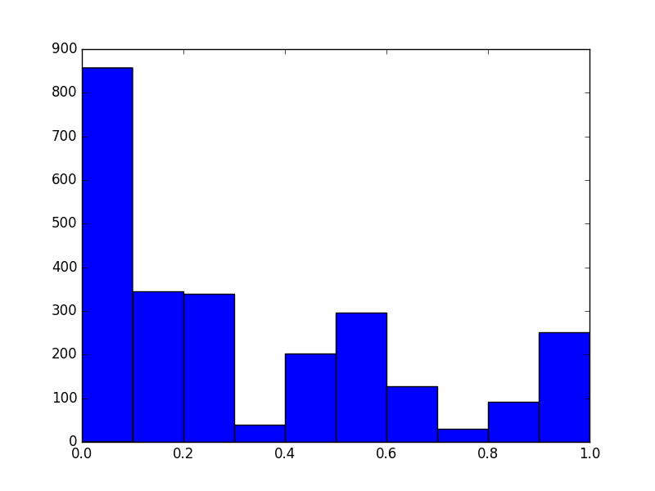
Labels

Slide 11
Framework/Codes
PyTorch and Keras were used as the frameworks to implement convolutional neural networks to conduct a regression analysis as well as a classification analysis to train and then predict the cellularity of the images.
The first network was a shallow network with two convolution networks as well as two pooling networks, two ReLUs and a final Linear layer as the output layer.

Slide 12
Framework/Codes
The second network was a deep network (ResNet).
The third network was dilated convolutional network.
The fourth network was DenseNet121.

Slide 13
Framework/Codes
The optimizer were:
Adam
SGD
The loss function were:
MSE
KLDiv (Kullback-Leibler Divergence Loss)
Crossentropy loss for Densenet

Slide 14
Framework/Codes
The learning rate was:
0.001
The batch size was:
Shallow model= 64 & 128
Resnet9 = 64
Dilated CNN= 25
Densenet121 = 12

Slide 15
Framework/Codes
Data was modified for classification.
VGG16 was used to predict a binary outcome (>=50% vs. <50%)

Slide 16
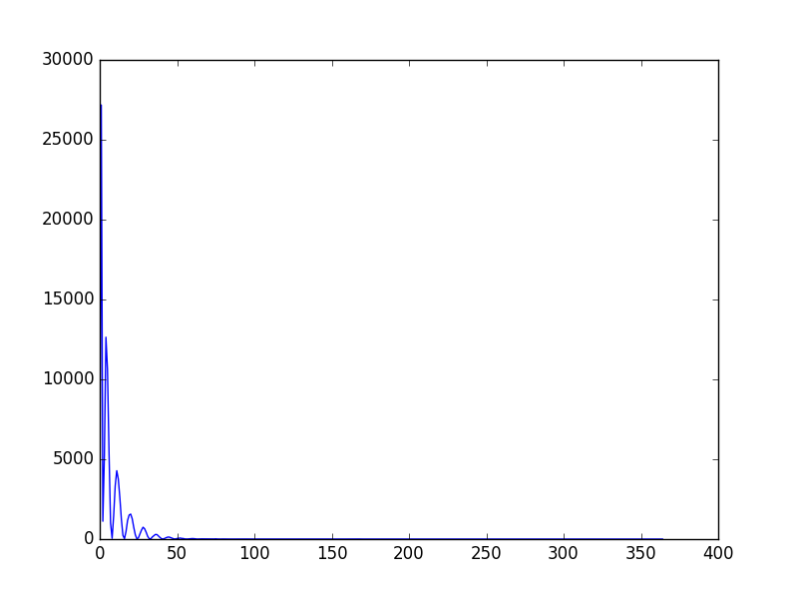
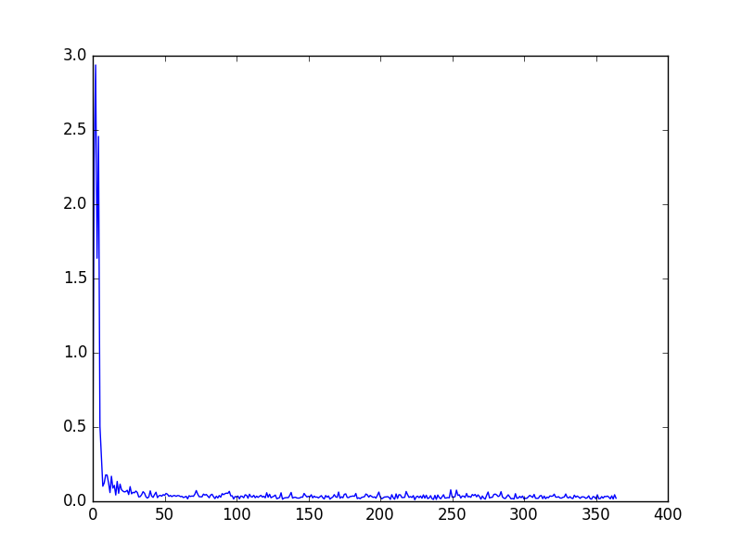
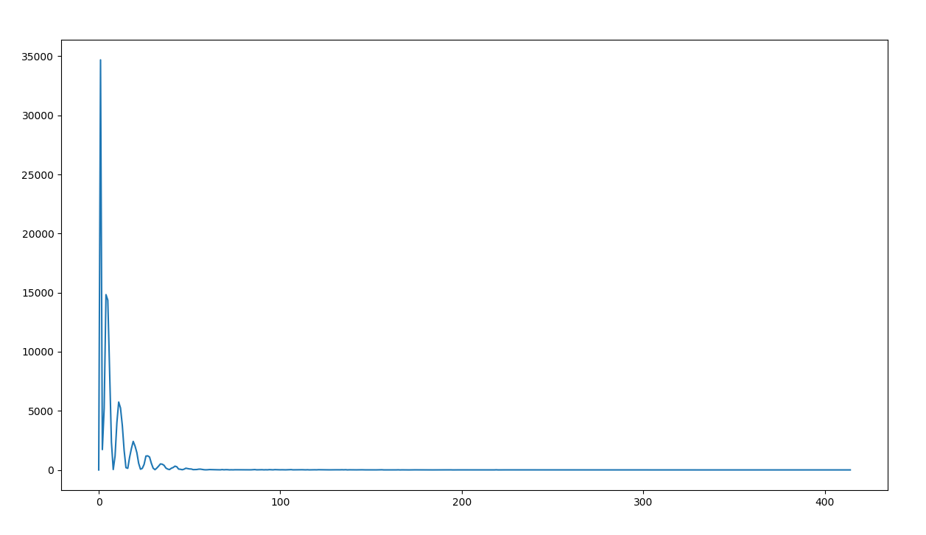
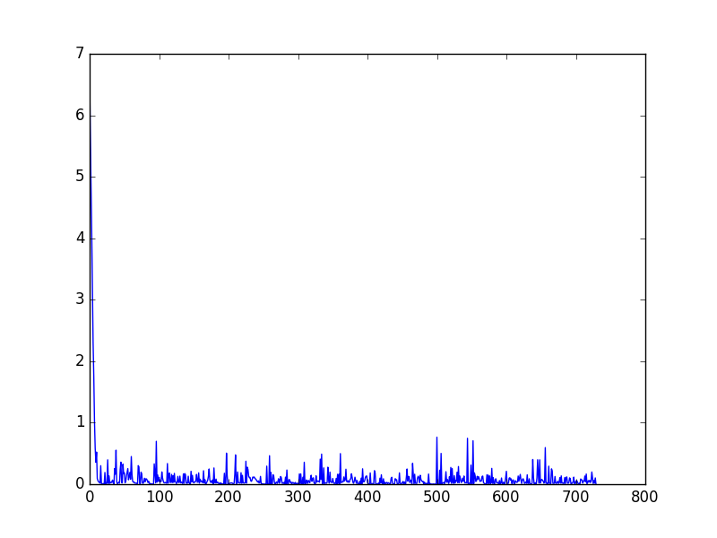
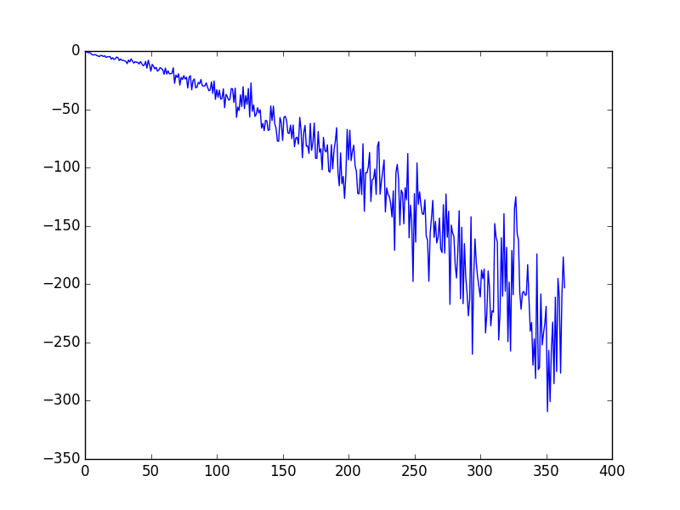
Loss Function
Shallow-MSE
Resnet9-MSE
Dilated CNN-MSE
Densenet121-Crossentropy
Resnet9-KLDiv

Slide 17
Results
Model | Loss function | Epochs | RMSE
CNN - 8 | MSE | 5 | 0.23
CNN - 8 | KLDiv | 5 | 0.21
CNN - 8 | MSE | 10 | 0.01
Resnet - 9 | MSE | 5 | 0.01
Resnet - 9 | KLDiv | 5 | 0.47
DilatedCNN-13 | MSE | 5 | 0.2
Densenet - 121 | Cross entropy | 5 | 0.26

Slide 18
Conclusions
Shallow network and deeper resnet networks achieved a very good RMSE during testing when MSE used as loss function.
Model would need to be trained on a larger dataset
May need multiple transformations to achieve a low enough RMSE to be considered for clinical use

Slide 19
Questions

